Slide 1
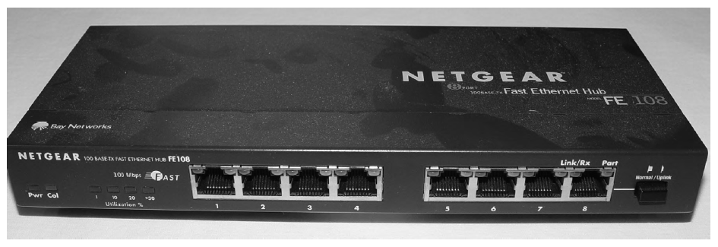
Chapter Six
Networking Devices
Common Network Connectivity Devices: - Because these devices connect network entities, they’re known as connectivity devices. Here’s a list of the devices.
Hub
Repeater
Modem
Network Interface Card (NIC) 5- Bridge
Basic Switch
Wireless access point (AP) 8- Basic router
Basic firewall
Basic Dynamic Host Configuration Protocol
1- Hub:-
A hub is the device that connects all the segments of the network together in a star topology Ethernet network. Every device in the network connects directly to the hub through a single cable and is used to connect multiple devices without segmenting a network. Any transmission received on one port will be sent out all the other ports in the hub, including the receiving pair for the transmitting device, so that Carrier Sense Multiple Access with Collision Detection (CSMA/CD) on the transmitter can monitor for collisions.

Slide 2
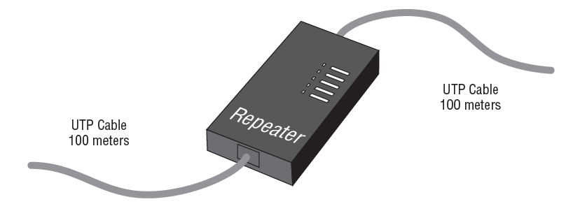
2- Repeater:-
Figure below shows a repeater being usedto connect two unshielded twisted-pair (UTP) connectors. This configuration will providean extension to your Ethernet segment and give you a gain of another 100 meters (328 feet).
Note: - It is important to remember that both hubs and repeaters are layer-1 devices and do not segment a network in any way.
3- Modem: -A modem is a device that modulates digital data onto an analog carrier for transmission over an analog medium and then demodulates from the analog carrier to a digital signal again at the receiving end. The term modem is actually an acronym that stands for MOdulator/DEModulator.
When you hear the term modem, three different types should come to mind:
Traditional (plain old telephoneservice [POTS])
DSL
Cable

Slide 3
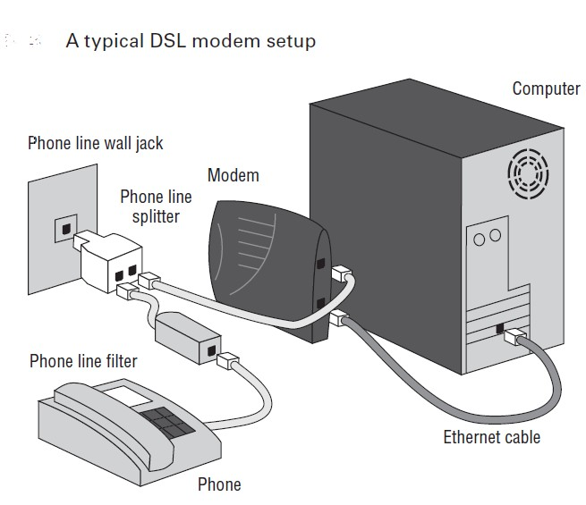
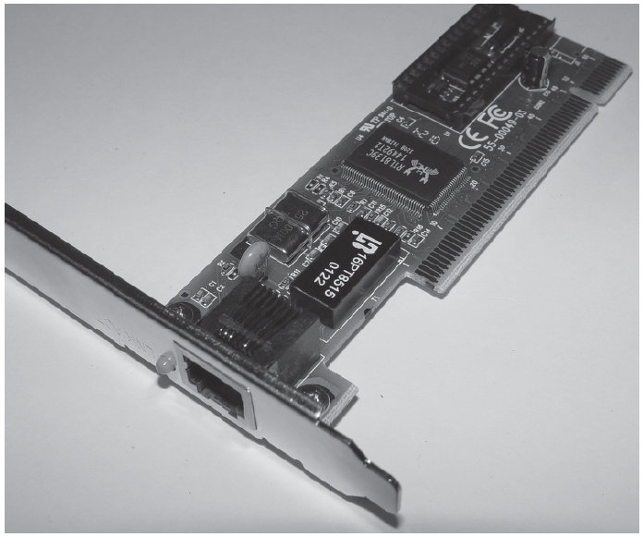
4- Network Interface Card (NIC):- A network Interface Card (NIC) is installed in computer to connect, or interface, computer to the network. It provides the physical, electrical, and electronic connections to the network media.Figure below shows a typical 100Mbps Ethernet NIC.

Slide 4
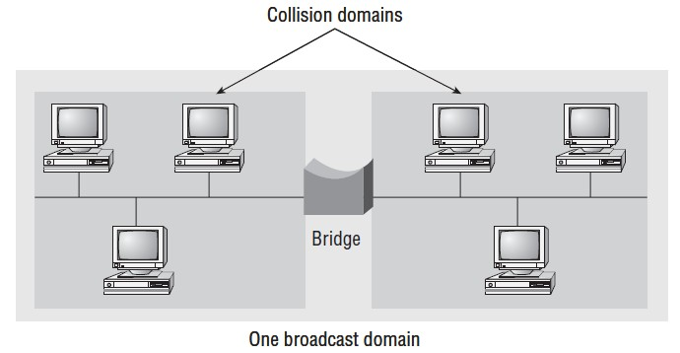
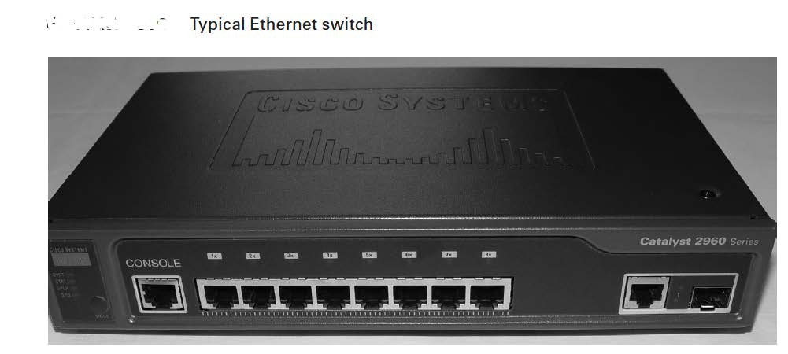
5- Bridge: - A bridge—specifically, a transparent bridge—is a network device that connects two similar network segments together. Its primary function is to keep traffic separated on either side of the bridge, breaking up collision domains, as pictured in Figure below.
6- Switches: -Switches connect multiple segments of a network together much like hubs do, but with three significant differences—a switch recognizes frames and pays attention to the source and destination MAC address of the incoming frame as well as the port on which it was received.
Note: - Switches are a Layer 2 device, which means they segment the network with MAC addresses. If you see the term “Layer 3 switch”, that means you are talking about a router, not a Layer 2 switch. The terms router and Layer 3 switch are interchangeable.

Slide 5
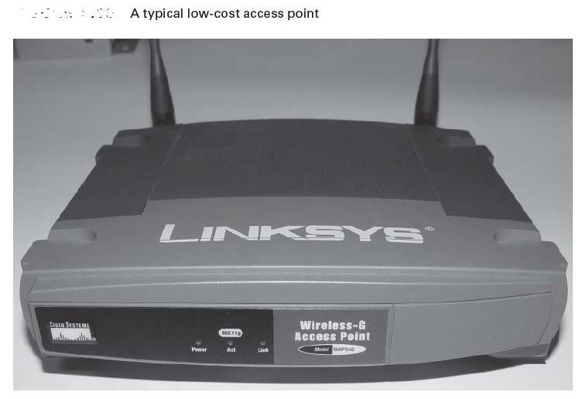
7- Wireless access point (AP):- A wireless access point (AP) allows mobile users to connect to a wired network wirelessly via radio frequency technologies. Using wireless technologies, APs also allow wired networks to connect to each other and are basically the wireless equivalent of hubs or switches because they can connect multiple wireless (and often wired) devices together to form a network. Figure below shows a typical low-cost access point.
One of the most popular uses for APs today is to provide Internet access in public areas like libraries, coffee shops, hotels, and airports.
8- Router: -A router is a network device used to connect many, sometimes disparate, network segmentstogether,combining them into what we call an internetwork. A well- configuredrouter can make intelligent decisions about the best way to get network data to its destination.It gathers the information it needs to make these decisions based on a network’s particularperformance data.Figurebelow shows a Small Office, Home Office (SOHO) router that provides wiredand wireless access for hosts and connects them to the Internet without any necessaryconfiguration.

Slide 6
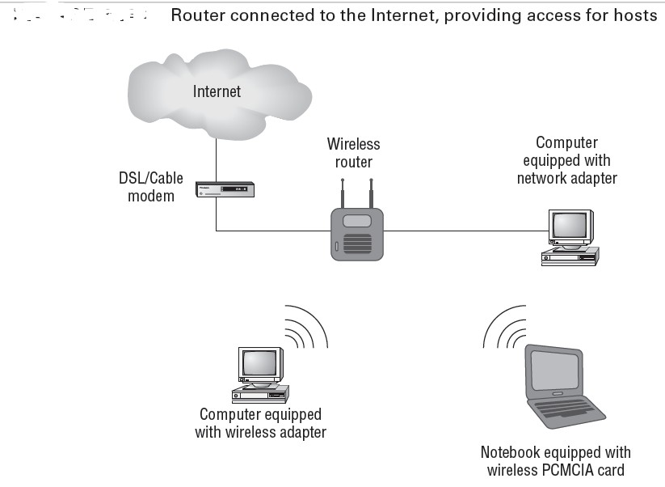
Note: - Routers can have many different names: layer-3 switch and multilayer switch are the most common, besides the name router, of course. Remember, if you just hear the word “switch”, that means a layer-2 device. Routers, layer-3 switches, and multilayer switches are all layer-3 devices.
9- Basic firewall: - Basically, firewalls are your network’s security guards; they’re probably the most important thing to implement on your network. That’s because today’s networks are almost always connected to the Internet—a situation that makes security crucial! A firewall protects your LAN resources from invaders that prowl the Internet for unprotected networks, while simultaneously preventing all or some of your LAN’s computers from accessing certain services on the Internet. A firewall can be either a stand- alone “black box” or a software implementation placed on a server or router. Either way, the firewall will have at least two network connections: one to the Internet (known as the public side) and one to the network (known as the private side). Sometimes, there is a second firewall, as shown in Figure below, this firewall is used to connect servers and equipment that can be considered both public and private (like web and email servers). This intermediary network is known as a demilitarized zone (DMZ).Firewalls are the first line of defense for an Internet-connected network.

Slide 7
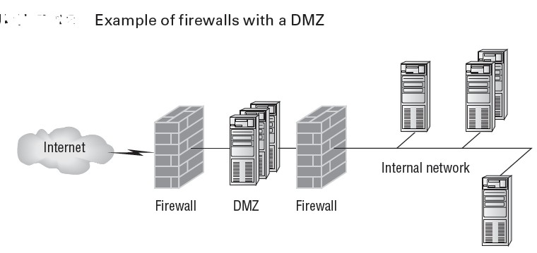
10- Dynamic Host Configuration Protocol (DHCP) Server:-
DHCP servers assign IP addresses to hosts. This protocol gives us a much easier way to administrate—by automatically providing IP information—than the alternative and tedious method known as static IP addressing, where we have to address each host manually. It works well in any network environment, from tiny to huge, and allows all types of hardware to be employed as a DHCP server, including routers. It works like this: A DHCP server receives request for IP information from a DHCP client using a broadcast. The only hitch is that if the DHCP server isn’t on the same segment as the DHCP client, the broadcast won’t be received by the server because by default, routers won’t forward broadcasts, as shown in Figure below.

